Slide 1
Advanced LabViEW
http://goo.gl/YdQ5mm

Slide 2
Customizing the Dashboard

Slide 3
Customizing the Dashboard
Open Project
Notes:
demo

Slide 4
Customizing the Dashboard
Open Project
Sending data from robot

Slide 5
Customizing the Dashboard
Open Project
Sending data from robot
Smart Dashboard VI’s
Named (case sensitive) values

Slide 6
Advanced Debugging Tools
VI Profiler
Tools>>Profile>>Performance and Memory
Notes:
Stop all running VIs. If you do not stop these VIs, the results that the Profile Performance and Memory window displays can be misleading or inconsistent.
Select Tools»Profile»Performance and Memory to display the Profile Performance and Memory window.
If you want to collect memory usage information, place a checkmark in the Profile memory usage checkbox. You cannot place a checkmark in this checkbox after starting the profiling session. Collecting information about VI memory use adds a significant amount of overhead to VI execution, which affects the accuracy of any timing statistics you gather during the profiling session. Therefore, you should perform memory profiling separate from time profiling.
Click the Start button in the Profile Performance and Memory window to begin the collection of performance data.
Run the VI you want to profile.

Slide 7
Advanced Debugging Tools
VI Profiler
Tools>>Profile>>Performance and Memory
Notes:
Stop all running VIs. If you do not stop these VIs, the results that the Profile Performance and Memory window displays can be misleading or inconsistent.
Select Tools»Profile»Performance and Memory to display the Profile Performance and Memory window.
If you want to collect memory usage information, place a checkmark in the Profile memory usage checkbox. You cannot place a checkmark in this checkbox after starting the profiling session. Collecting information about VI memory use adds a significant amount of overhead to VI execution, which affects the accuracy of any timing statistics you gather during the profiling session. Therefore, you should perform memory profiling separate from time profiling.
Click the Start button in the Profile Performance and Memory window to begin the collection of performance data.
Run the VI you want to profile.

Slide 8
Functional Global Variable

Slide 9
Functional Global Variable
Quick Intro
https://frclabviewtutorials.com/fgv/
Notes:
demo

Slide 10
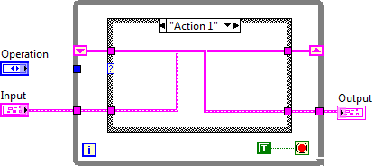
FGV
Functional Global Variable Code

Slide 11
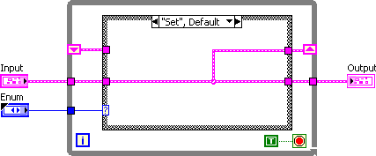
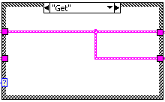
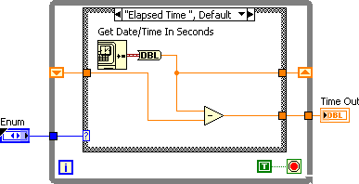
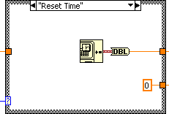
Implementing An FGV

Slide 12
VI Properties
Quick Intro
https://frclabviewtutorials.com/fgv/
SR Flip Flop Demo
Notes:
Demo SR

Slide 13
VI Properties
Quick Intro
https://frclabviewtutorials.com/fgv/
SR Flip Flop Demo
Edge Detector
https://frclabviewtutorials.com/memory-library/
Notes:
Demo edge detetector

Slide 14
FRC Vision Programming
Demo

Slide 15
PID
Proportional
Notes:
https://docs.google.com/viewer?a=v&pid=sites&srcid=aGFyZGluZy5lZHV8dGVhbS0zOTM3fGd4OjUyNzdiNzRkNjkxNjA3MGM
https://www.youtube.com/watch?v=JEpWlTl95Tw
https://www.youtube.com/watch?v=UR0hOmjaHp0
http://robotics.stackexchange.com/questions/167/what-are-good-strategies-for-tuning-pid-loops

Slide 16
PID
Proportional
Constant multiplied by error (offset)
The larger this is, the faster the robot approaches the setpoint (smaller rise time)

Slide 17
PID
Proportional
Constant multiplied by error (offset)
The larger this is, the faster the robot approaches the setpoint (smaller rise time)
Integral
Constant multiplied by integral of all previous error values
The larger this is, the less overshoot and settling time (less bounce)

Slide 18
PID
Proportional
Constant multiplied by error (offset)
The larger this is, the faster the robot approaches the setpoint (smaller rise time)
Integral
Constant multiplied by integral of all previous error values
The larger this is, the less overshoot and settling time (less bounce)
Differential
Used to eliminate steady state error (reducing offset after movement)

Slide 19
PID
Proportional
Constant multiplied by error (offset)
The larger this is, the faster the robot approaches the setpoint (smaller rise time)
Integral
Constant multiplied by integral of all previous error values
The larger this is, the less overshoot and settling time (less bounce)
Differential
Used to eliminate steady state error (reducing offset after movement)

Slide 20
PID
Tuning

Slide 21
PID
Tuning
Several methods available
Ziegler–Nichols*
Tyreus Luyben
Cohen–Coon
Åström-Hägglund
Manual Tuning*
Notes:
http://faculty.mercer.edu/jenkins_he/documents/TuningforPIDControllers.pdf#page=6
https://www.youtube.com/watch?v=JEpWlTl95Tw
https://www.youtube.com/watch?v=UR0hOmjaHp0
http://robotics.stackexchange.com/questions/167/what-are-good-strategies-for-tuning-pid-loops
Ziegler-Nichols: http://robotsforroboticists.com/pid-control/
Manual (page 16): https://docs.google.com/viewer?a=v&pid=sites&srcid=aGFyZGluZy5lZHV8dGVhbS0zOTM3fGd4OjUyNzdiNzRkNjkxNjA3MGM
http://www.ni.com/white-paper/3782/en/

Slide 22
PID
Tuning
Manuel
Raise C_{P} Until robot oscillates about setpoint
Raise C_{D} Until Robot stops bouncing
Raise C_{I} (and change the setpoint) until robot turns and hits the target point
Ziegler-Nichols
Raise C_{P} Until robot oscillates (Value of C_{P} becomes K_{u})
Measure the period of this oscillation (Time to complete 1 cycle becomes T_{U})

Slide 23
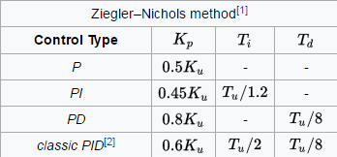
PID
Tuning
Manuel
Raise C_{P} Until robot oscillates about setpoint
Raise C_{D} Until Robot stops bouncing
Raise C_{I} (and change the setpoint) until robot turns and hits the target point
Ziegler-Nichols
Raise C_{P} Until robot oscillates (Value of C_{P} becomes K_{u})
Measure the period of this oscillation (Time to complete 1 cycle becomes T_{U})

Slide 24
PID
Tuning
Manuel
Raise C_{P} Until robot oscillates about setpoint
Raise C_{D} Until Robot stops bouncing
Raise C_{I} (and change the setpoint) until robot turns and hits the target point
Ziegler-Nichols
Raise C_{P} Until robot oscillates (Value of C_{P} becomes K_{u})
Measure the period of this oscillation (Time to complete 1 cycle becomes T_{U})

Slide 25
PID
Demo

Slide 26
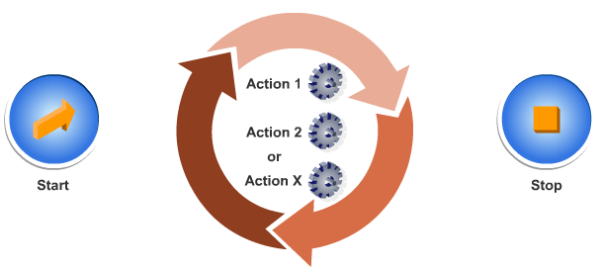
Architectures
State Machine

Slide 27
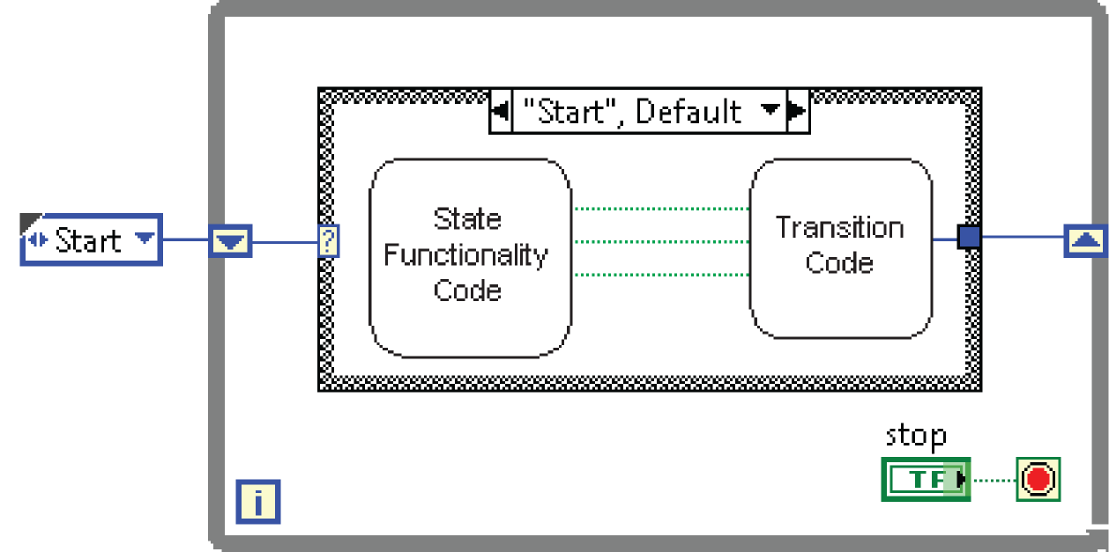
Architectures
State Machine

Slide 28
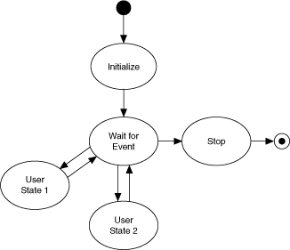
Architectures
State Machine

Slide 29
Architectures
State Machine
Producer-Consumer
Parallel loops
First creating data or instructions
Other handling

Slide 30
Architectures
State Machine
Producer-Consumer
Parallel loops
Use either queue or fgv

Slide 31
Producer Consumer Demo
Notes:
Queue and FGV

Slide 32
Type Def.
Useful for passing data – both controls and indicators
Demo

Slide 33
Type Def.
Useful for passing data – both controls and indicators
Demo
Notes:
typedefs

Slide 34
OOP and LVOOP
Object Oriented Programming
Used in C++, C#, Java, Python, etc.
A method of grouping where
An object represents the data
Has attributes and/or properties
Has methods that act on the object and its properties
LVOOP is OOP in LabVIEW

Slide 35
LVOOP
Demos – custom motor control

Slide 36
LVOOP
Demos – custom motor control
Create a class

Slide 37
LVOOP
Demos – custom motor control
Create a class
Create methods

Slide 38
LVOOP
Demos – custom motor control
Create a class
Create methods
Create an object

Slide 39
Questions

